Slide 1

Case Study 2
Michael Schulte

Slide 2
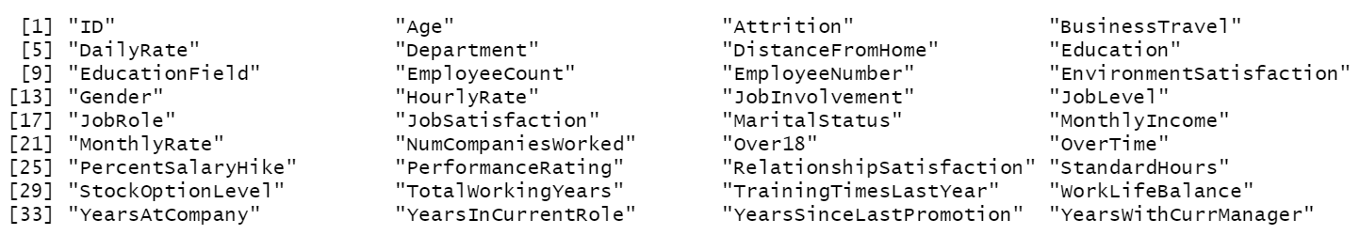
The Data
36 columns
870 observations
Column names:

Slide 3
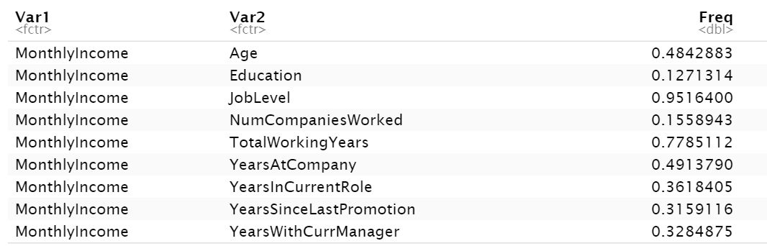
EDA - MonthlyIncome

Slide 4
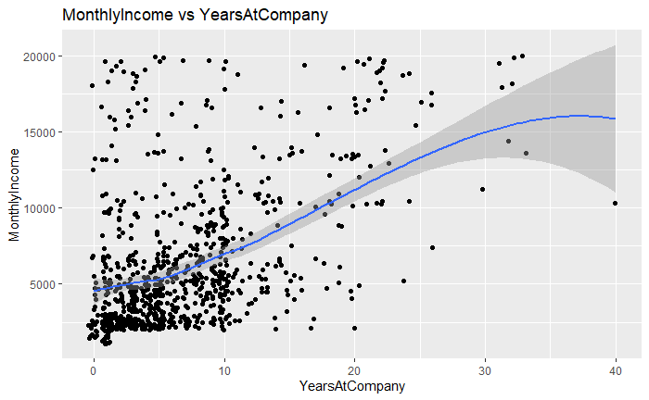
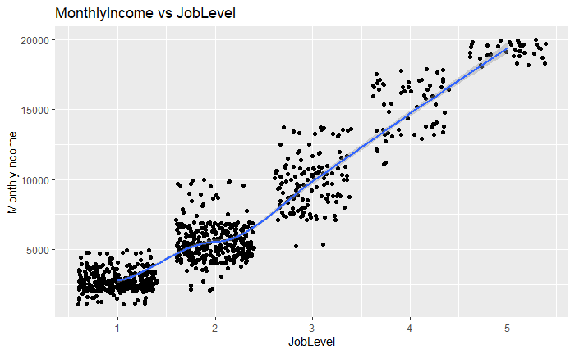
EDA - MonthlyIncome

Slide 5
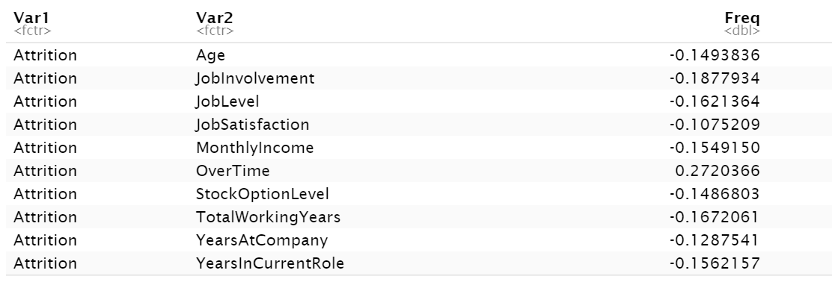
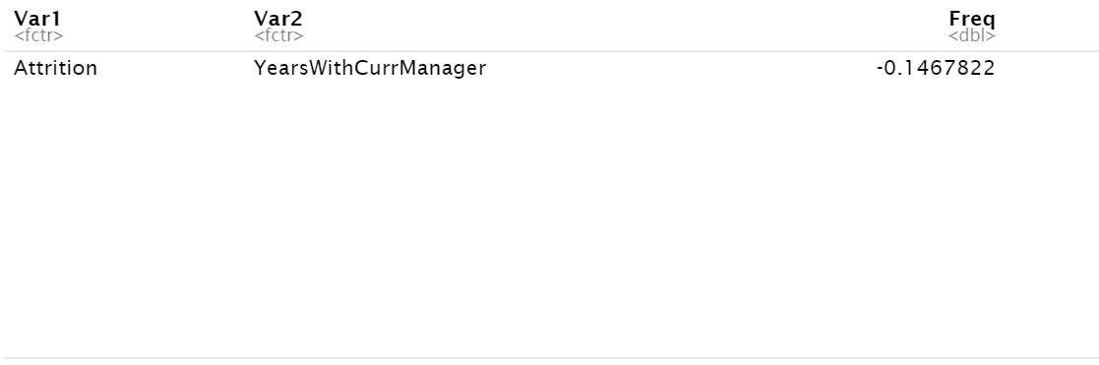
EDA – Attrition

Slide 6
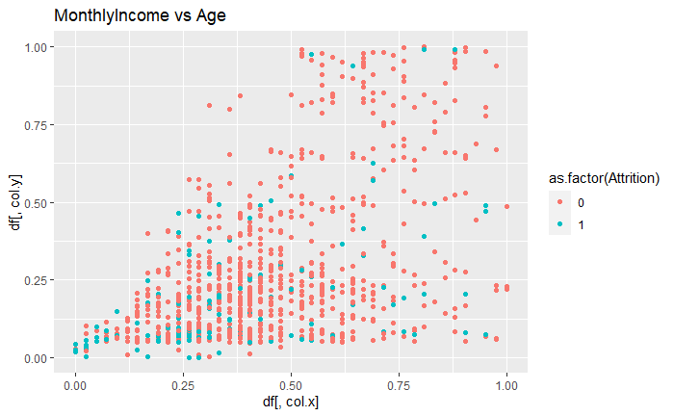
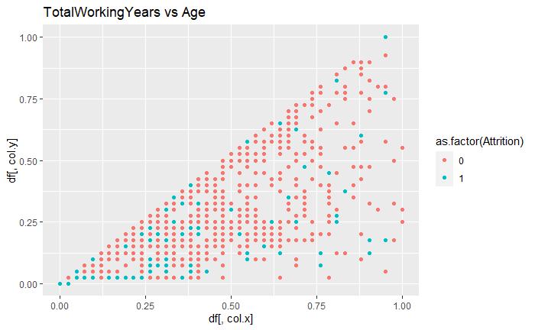
EDA – Attrition

Slide 7
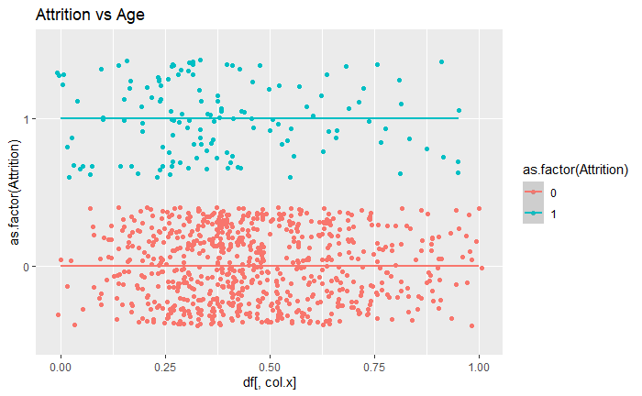
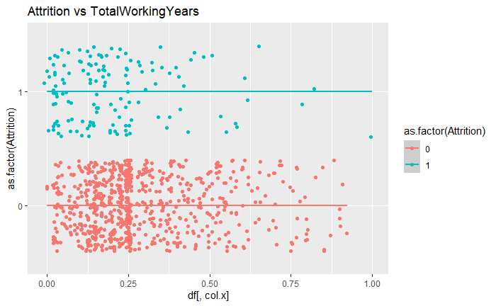
EDA – Attrition

Slide 8
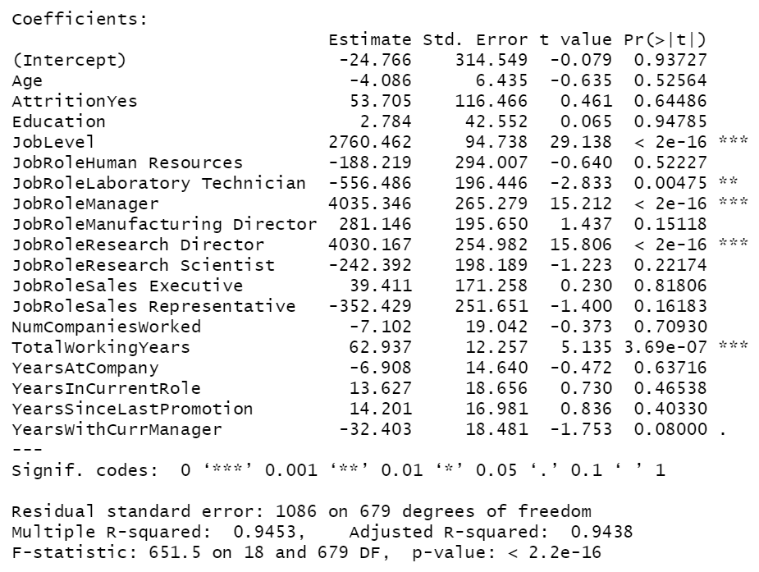
MLR Model – MonthlyIncome
RMSE = 977.342

Slide 9
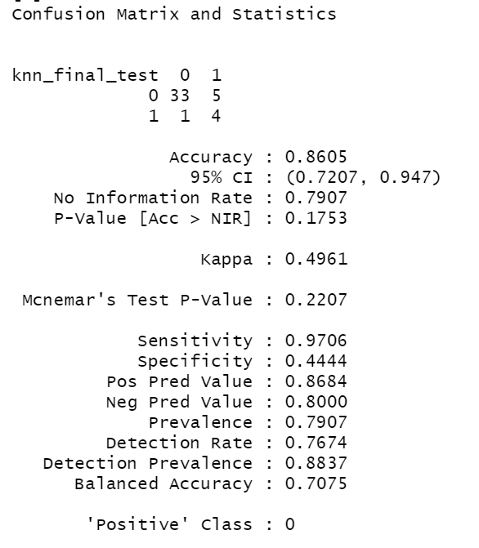
K-NN Model – Attrition
Expect Specificity to increase as more data is introduced into the train portion of the model.

Slide 10
Discussion
Different models to be used for classification
Naive Bayes
Multiple Logistic Regression
Random Forest
Other areas to collect data on
Reason for attrition if known
Retirement

